Slide 1

SMS
(Student Management System)
By : Aryan Gupta
Mentor : Kapil Hirapara

Slide 2

Objective
To Develop a Student Management System using ASP .net MVC with functionalities:
User Register and Login
CRUD Operations and Validations
Search and Pagination
Encryption and Decryption of Password

Slide 3
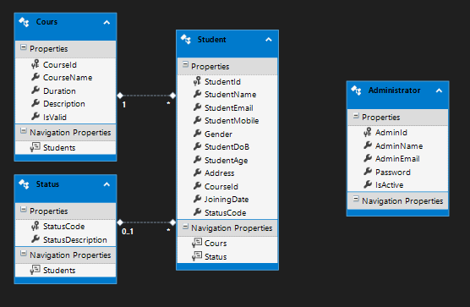
DB Diagram

Slide 4
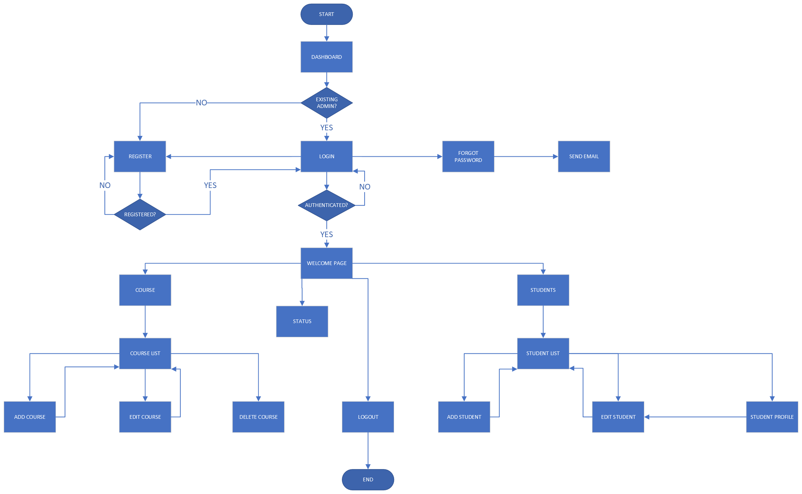
FLOWCHART

Slide 5
Innovation
Custom Validation
Forget Password
FK Dependency
User can not register with already registered Email.
Age validator: A student with age less than 16 cannot register.
User will receive an Email with their Id and Password once they are authenticated.
A course in which students are enrolled cannot be deleted.

Slide 6

Project
Demonstration

Slide 7


Thank you
Aryan.Gupta@oneadvanced.com

